Slide 1
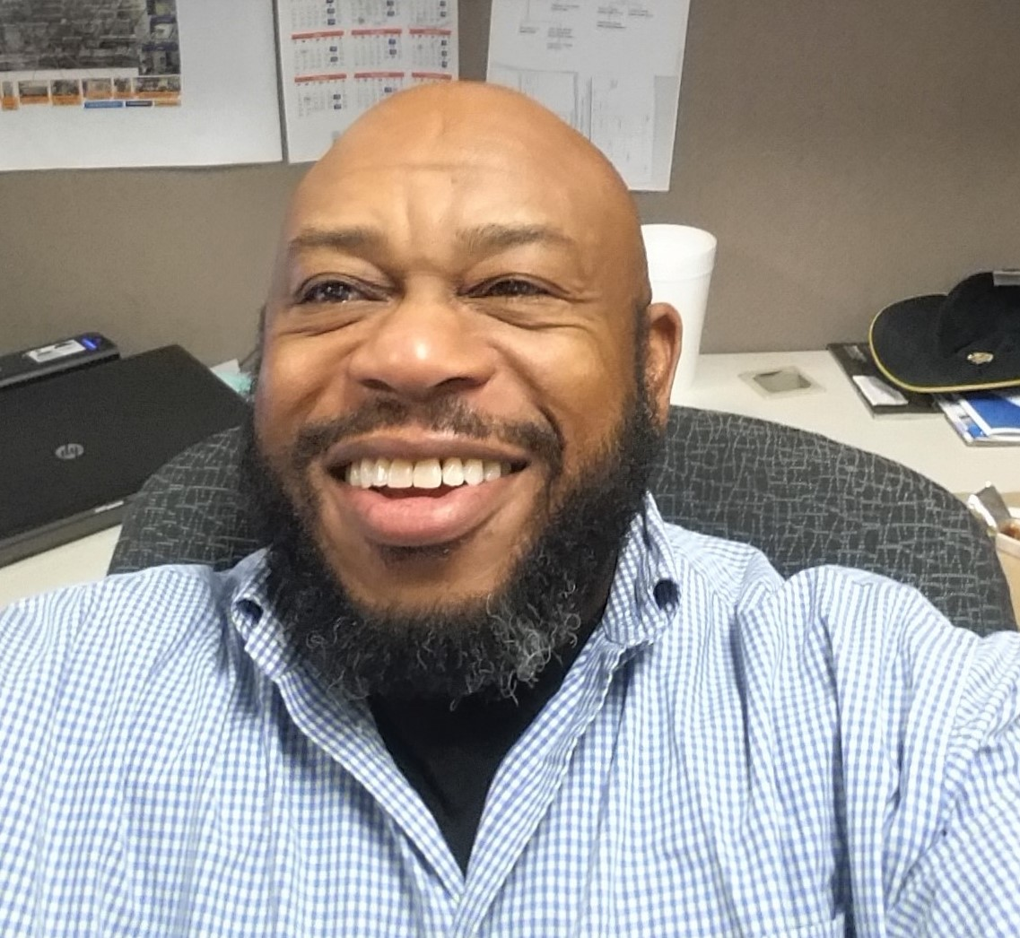
Jimmy Harris

Slide 2
How to generate income
What is easiest way to go from $100,000 to $300,000 to $600,00 to $1,000,000 in income? Start or Own a Business
Business ownership IS the path to earning $1,000,000 for yourself.
You must have the ability to offer products and services in the marketplace and generate a profit.

Slide 3
How to generate income
Business ownership IS the path to earning $1,000,000 and more for yourself and the people you love.
It is the Greatest Feeling to offer products and services in the marketplace and make a profit.
To offer products and services in the marketplace, you need capital.
Money gives you the ability to execute and expand your business.

Slide 4
This Training will give you the tools you need to Start Grow and Fund Your Business
1. Identity what you want
2. make a list and establish requirements for yourself
3. Execute

Slide 5
Identify what you want
Spend time alone to declutter your mind
Eliminate those things that waste your time
Think about that which you want to accomplish and write it down
It must be a solution to a problem or need
You MUST increase your income by providing solutions in the marketplace.

Slide 6
Create a set of requirements for yourself Find a Solution to someone’s problem
To make money, you need to solve problems
When you solve someone else’s problem, you solve your own dilemma
Your dilemma is the need to See your income increase--week by week
You want to dramatically increase your income so you can see how to create financial independence for yourself, your wife or husband
Notice, I did not mention the kids.
They will have the opportunity to make it happen for themselves

Slide 7
Think big and Take massive action
Make sure that what you are doing is big enough to get other people to make a commitment
People with money get behind big ideas
Whatever the size of your idea, make it 10 times in size and revenue
Money helps you Feel and See the effects of what you are doing
Money will help make things happen quicker and faster

Slide 8
Develop a set of requirements for yourself or Your Business
Create a set of requirements that will enable you to sell your products and services as a Solution
Get your business validated legally to do business, worldwide
Get Certificates and Certifications to do business with Fortune 500 companies (large, medium, and small companies) and the US Government
Create a list of companies that might want your products or services

Slide 9
Create a Website take all major credit cards
Create a website—you don’t need something fancy
Basic five page website with Paypal integration
PayPal – immediate trust, confidence, and security in customer information
Include form to capture information at front end of website
Make sure you have a Privacy Notice link
What is a Privacy Notice

Slide 10
Fund your Requirements or business
Get access to $300,000 to grow your business
You need cash to support the massive action that you will take
You cannot sustain a business with little or no money
Remove the thought from your mind
You will have a permeant secondary source to capital—You need this!

Slide 11
Yes, I need this!
Get a registered and legal business in your company name delivered to your In-Box
Enhance your existing business so you can do business with large, medium, and small (1,000’s of companies), and the US Government
Get $300,000 to grow your existing business
You will have a permanent secondary source of capital—You need this!

Slide 12
Yes, I want this! Consider it Done
Company of your choice with commercial and government registrations and certification
Do business with Fortune 500 companies (large, medium, and small companies) and the US Government
You will receive EIN, CAGE, and Certification as a US National Supplier
Website and company telephone number
$1,997
OR
3 Monthly Payments - $700

Slide 13
Yes, I want this!
Access to $300,000 to operate your business
It’s simple – Pay $1997
Get access to Lines of Credit and High Limit Credit Cards
$1,997

